Slide 1
Introduction to Deep Learning

Slide 2
What you will (hopefully) learn:
Understand what drives AI innovations
Application (pythonic libraries: Tensorflow, scikitlearn, etc.)
ML Intuition (math, general principles of ML)

Slide 3
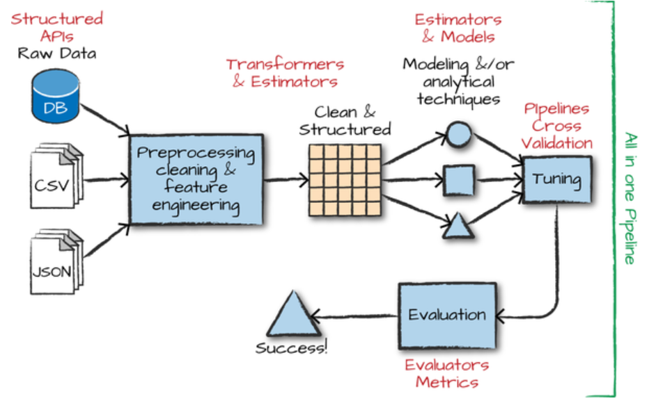

Slide 4
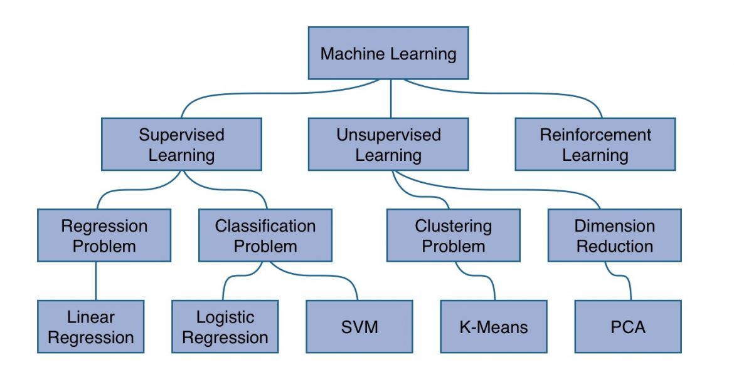
Types of machine learning

Slide 5
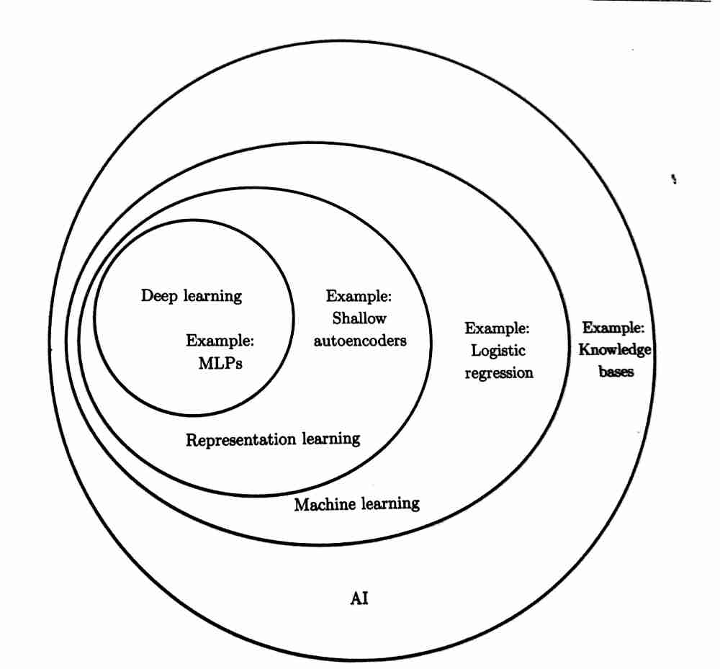

Slide 6
Recap and Reinforce: Linear regression and Logistic regression
Input: X
Labels: Y
Training set
Validation set
Test set

Slide 7
Training set(X)
Model(𝜃)
Hypothesis(H)
Cost Function(J)
Optimizer(O)
H - Predictions that machine learning model outputs when given some input.
J - Calculates the difference between the predictions and the actual answers (labels). Basically indicates how ‘wrong’ the model is.
O - Updates theta by making the model internalize the cost.
Goal of learning: To learn theta well enough so as to...minimize the cost function???
WRONG!!! The goal of learning is to learn theta well enough so that future predictions made on test cases can be as accurate as possible.

Slide 8
So we still need to test the model...but why do we need 2 separate sets for that? (Validation versus test set)
Remember...
Learning rate - alpha
Regularization term - lambda
Number of training cycles/epochs, batch size and many more…
Validation sets help us to find the best hyperparameters for the model (hyperparameter tuning)
After all that...the test set is then run through the “trained and validated” model, to give the accuracy score of the model.

Slide 9

Today: MLP (Multilayer Perceptron)
Allows for the model to map more complex functions that single layer ML models cannot map.

Slide 10
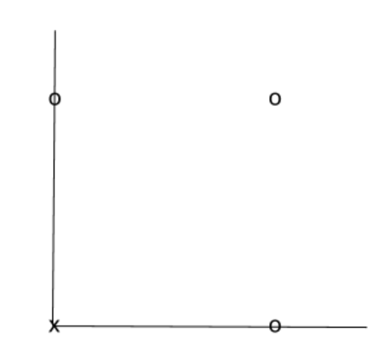
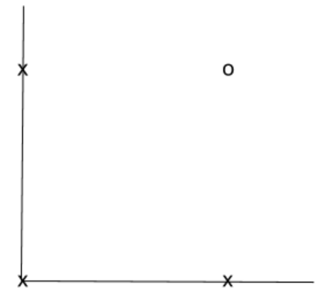
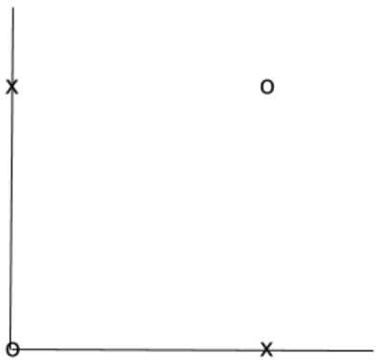
OR
AND
???
XNOR

Slide 11

Let’s try to construct a XNOR gate using a MLP!
We will use the sigmoid function, where:
Taking 𝜃1 = [ -30, 20, 20], i.e. h(x) = g(-30+20X₁ +20X₂ ),
0 | 0 | ~0
1 | 0 | ~0
0 | 1 | ~0
1 | 1 | ~1
𝜃1 can be used to represent a AND gate!

Slide 12
Likewise…
𝜃2 = [-10, 20, 20] can represent a OR gate.
𝜃3 = [10, -20, -20] can represent a NOR gate.
X1 | X2 | A1(X1 AND X2) | A2(X1 NOR X2) | H (A1 OR A2)
0 | 0 | 0 | 1 | 1
1 | 0 | 0 | 0 | 0
0 | 1 | 0 | 0 | 0
1 | 1 | 1 | 0 | 1

Slide 13
+1
+1
-30
-10
X1
A1
H
20
20
10
-20
20
20
X2
A2
-20
Notes:
https://youtu.be/aircAruvnKk
https://medium.com/@jayeshbahire/perceptron-and-backpropagation-970d752f4e44
https://medium.com/@tiago.tmleite/neural-networks-multilayer-perceptron-and-the-backpropagation-algorithm-a5cd5b904fde

Slide 14
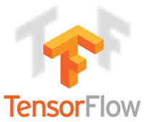
Introduction to Tensorflow
Open source framework for developing machine learning models and algorithms, most notably neural networks.
How do we picture tensorflow? Basis of tensorflow is a dataflow graph.
Graphs consist of 2 main parts: nodes and edges. Nodes represent mathematical operations, while edges represent multidimensional arrays/tensors.

Slide 15
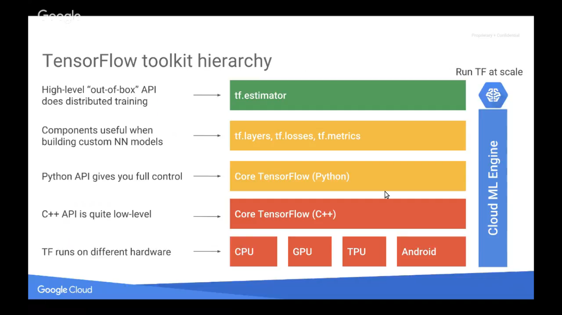
(Keras)
Notes:
https://www.tensorflow.org/api_docs/python/

Slide 16
PRACTICE!

Slide 17
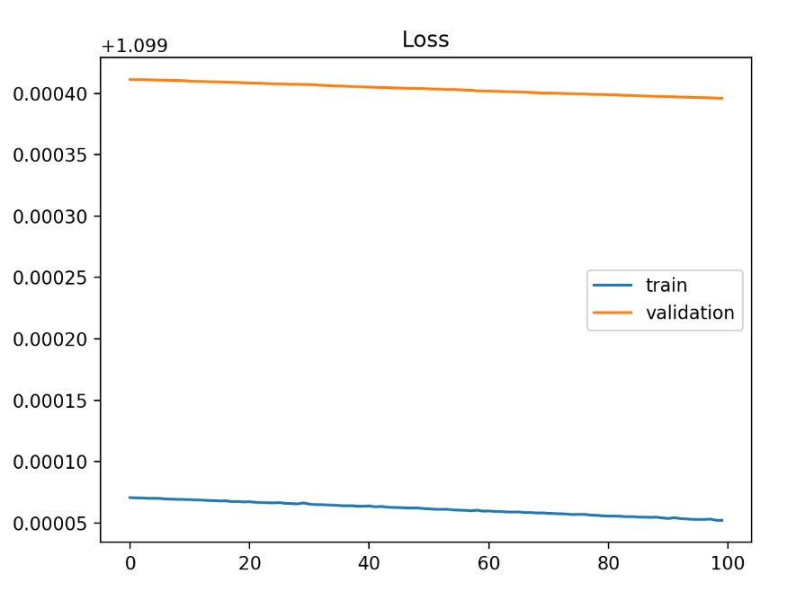
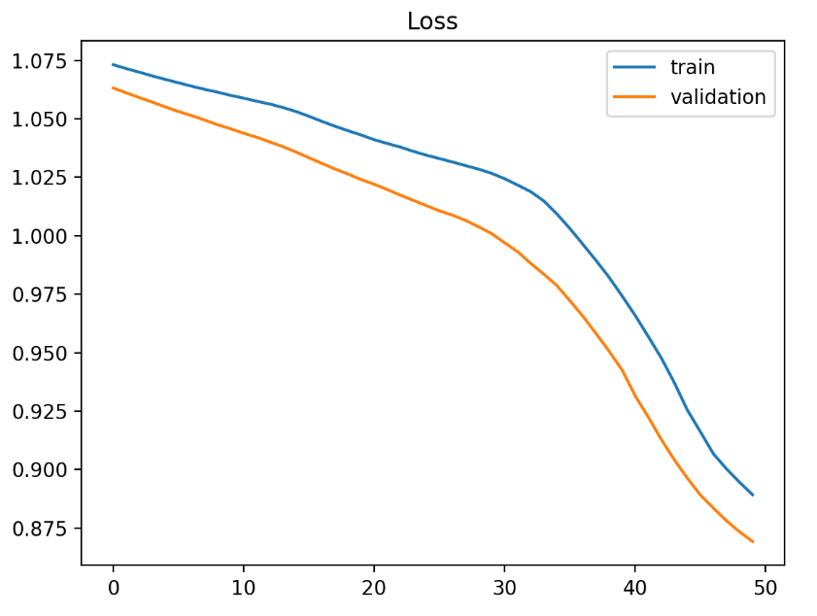
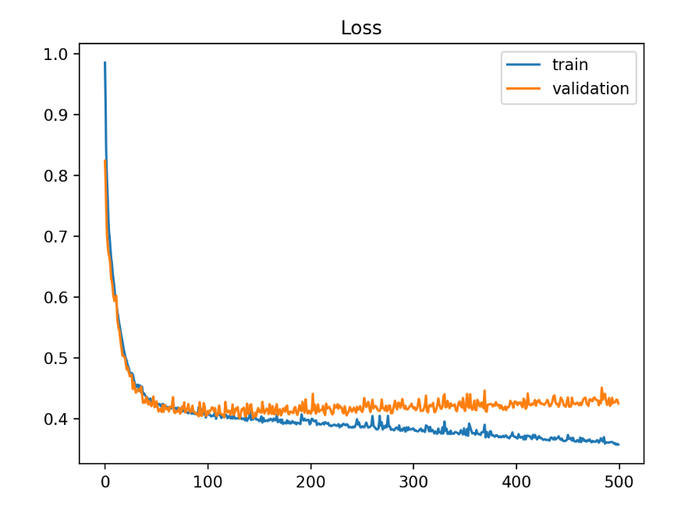
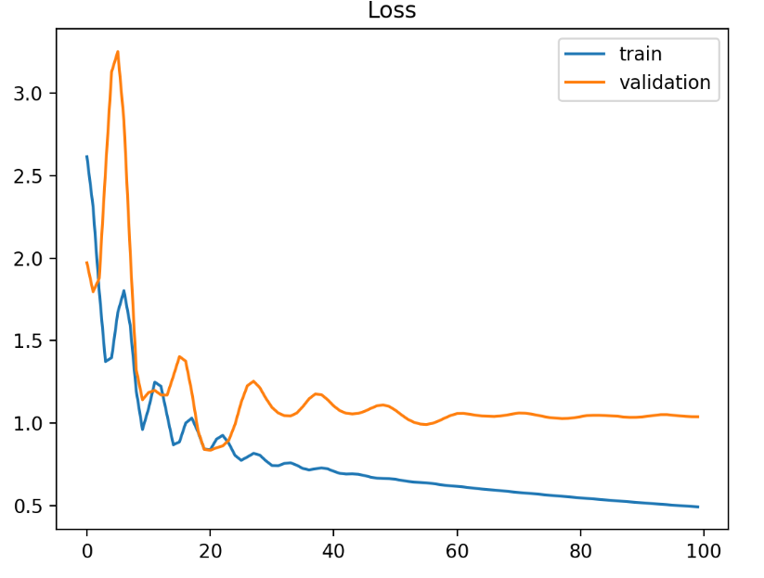
Cost curves: Good fit or not?

Slide 18
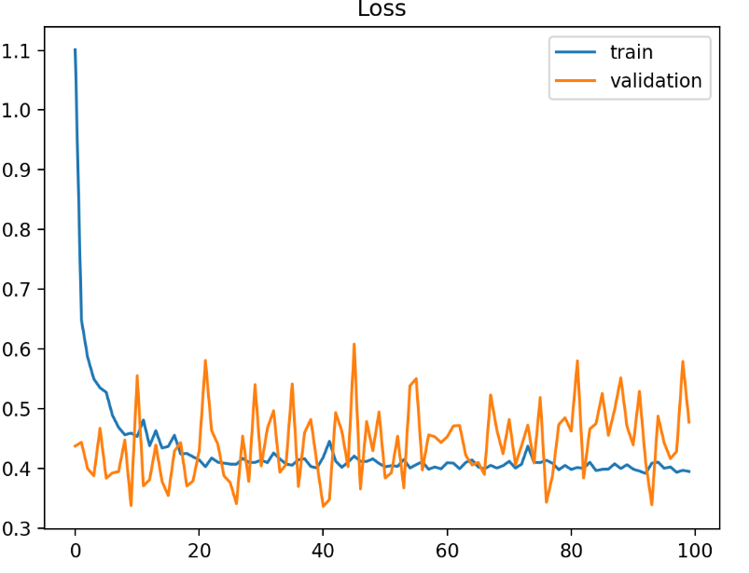
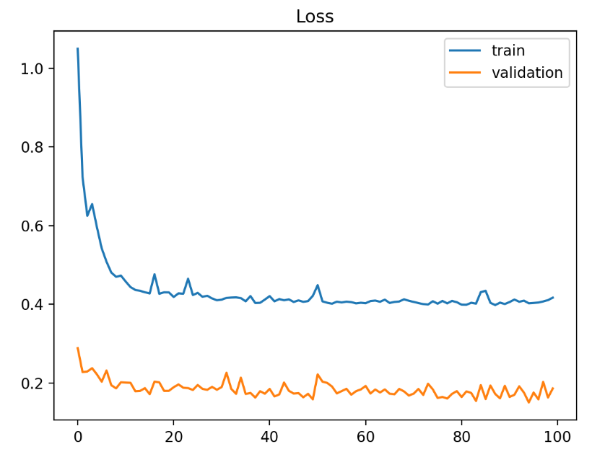
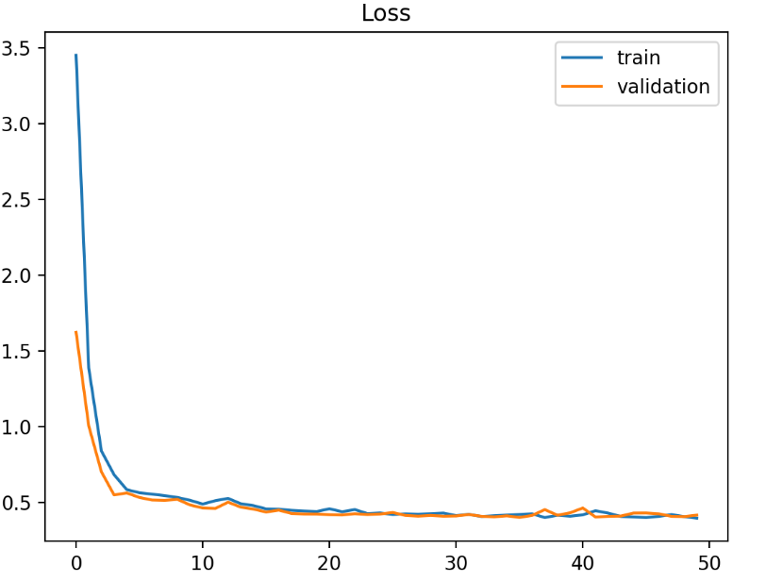
Cost curves: Good fit or not?

Slide 19
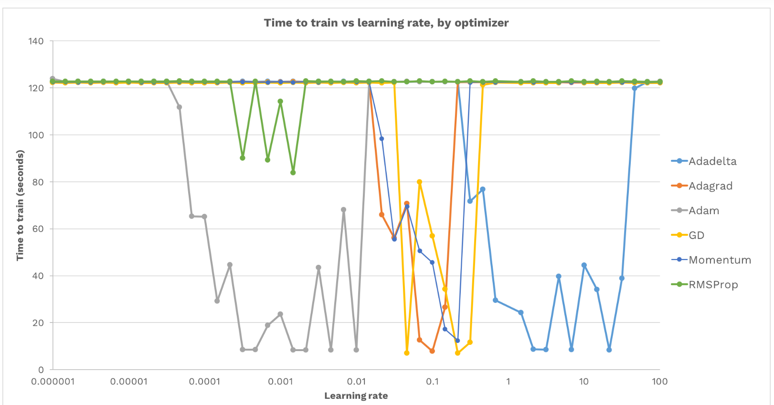
Notes:
https://medium.com/octavian-ai/which-optimizer-and-learning-rate-should-i-use-for-deep-learning-5acb418f9b2

Slide 20
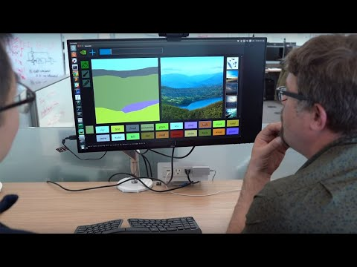
GANs - How do they work?
Notes:
https://pathmind.com/wiki/generative-adversarial-network-gan
https://github.com/nashory/gans-awesome-applications

